Slide 1
Chapter 7
Lesson 2
The Water Cycle
Pages 176-183

Slide 2
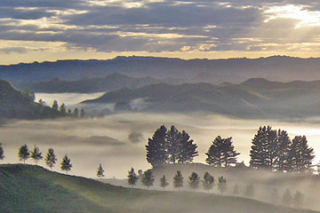
1. Water moves from Earth’s surface into the atmosphere.

Slide 3
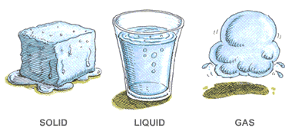
2. Water changes state as it moves.

Slide 4
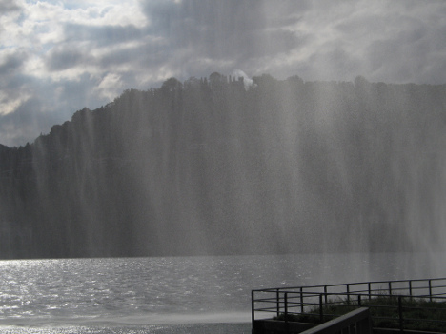
3. Water in the gas state is called water vapor.

Slide 5
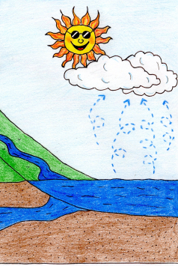
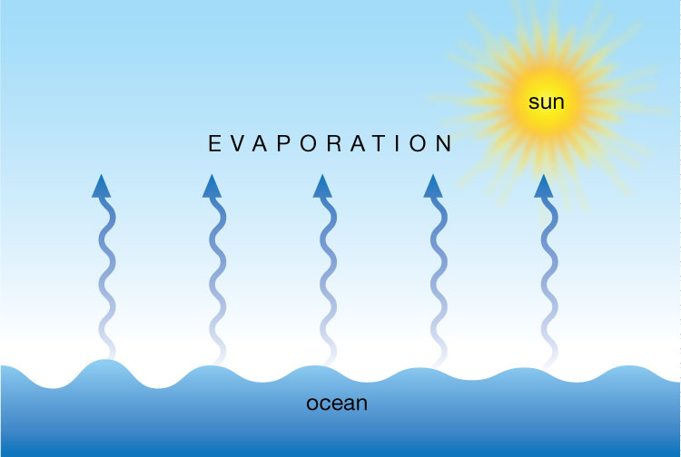
4. The process during which a liquid slowly changes to a gas is called evaporation. Heat from the Sun causes ocean water to evaporate.

Slide 6
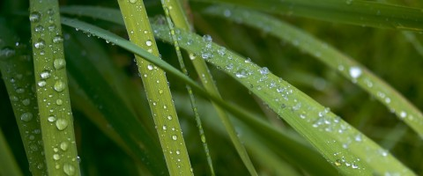
5. The process during which a gas changes to a liquid is called condensation. When the air cools, water vapor condenses on objects; for example, dew forms on grass.

Slide 7
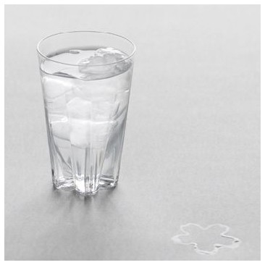
Condensation

Slide 8
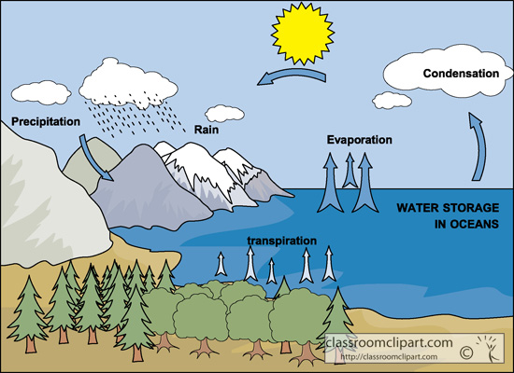
6. Earth’s water is constantly changing state by moving through the water cycle.

Slide 9
7. When water vapor rises, it cools and condenses; this forms clouds.

Slide 10
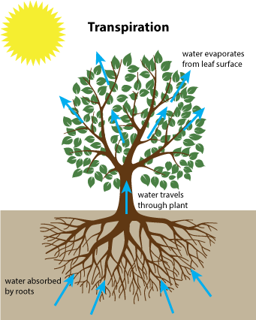
8. When water evaporates from the leaves of plants, it is called transpiration.

Slide 11
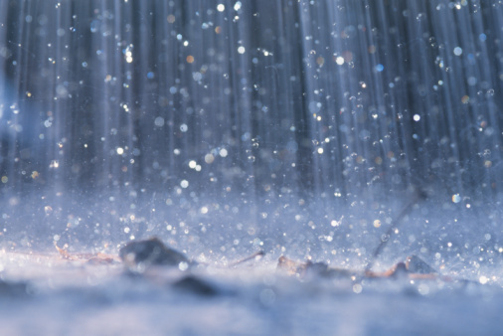
9. Rain, snow, sleet, and hail are different forms of precipitation.

Slide 12
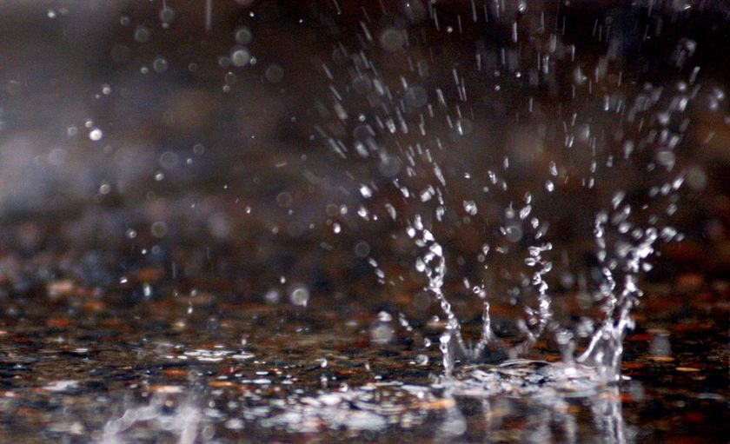
Rain, precipitation in a liquid form, is the most common type of precipitation. When precipitation freezes, or changes from a liquid to a solid, different types of precipitation is formed.

Slide 13
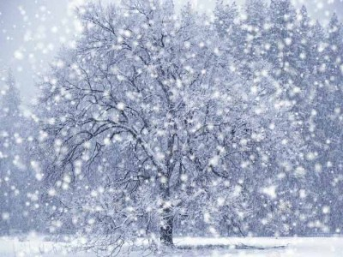
10. When bits of ice crystals form in clouds, they may fall to the ground as snow.

Slide 14
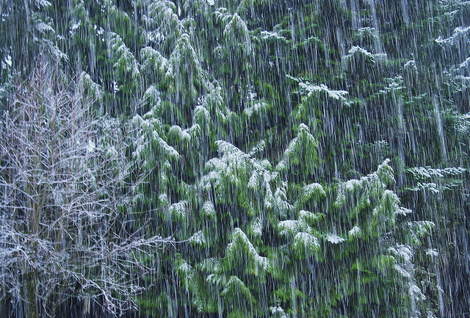
Sleet is formed when water droplets fall from clouds as rain but freeze on the way to the Earth’s surface.

Slide 15
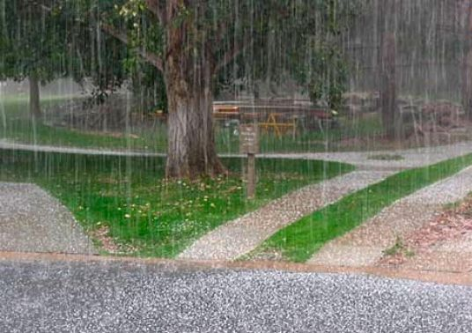
11. Hailstones form inside the tall clouds of a thunderstorm and are usually the size of peas.

Slide 16
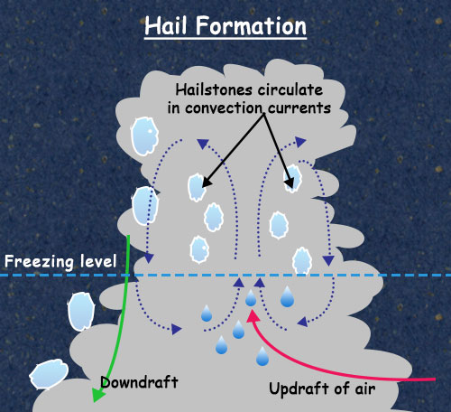

Slide 17
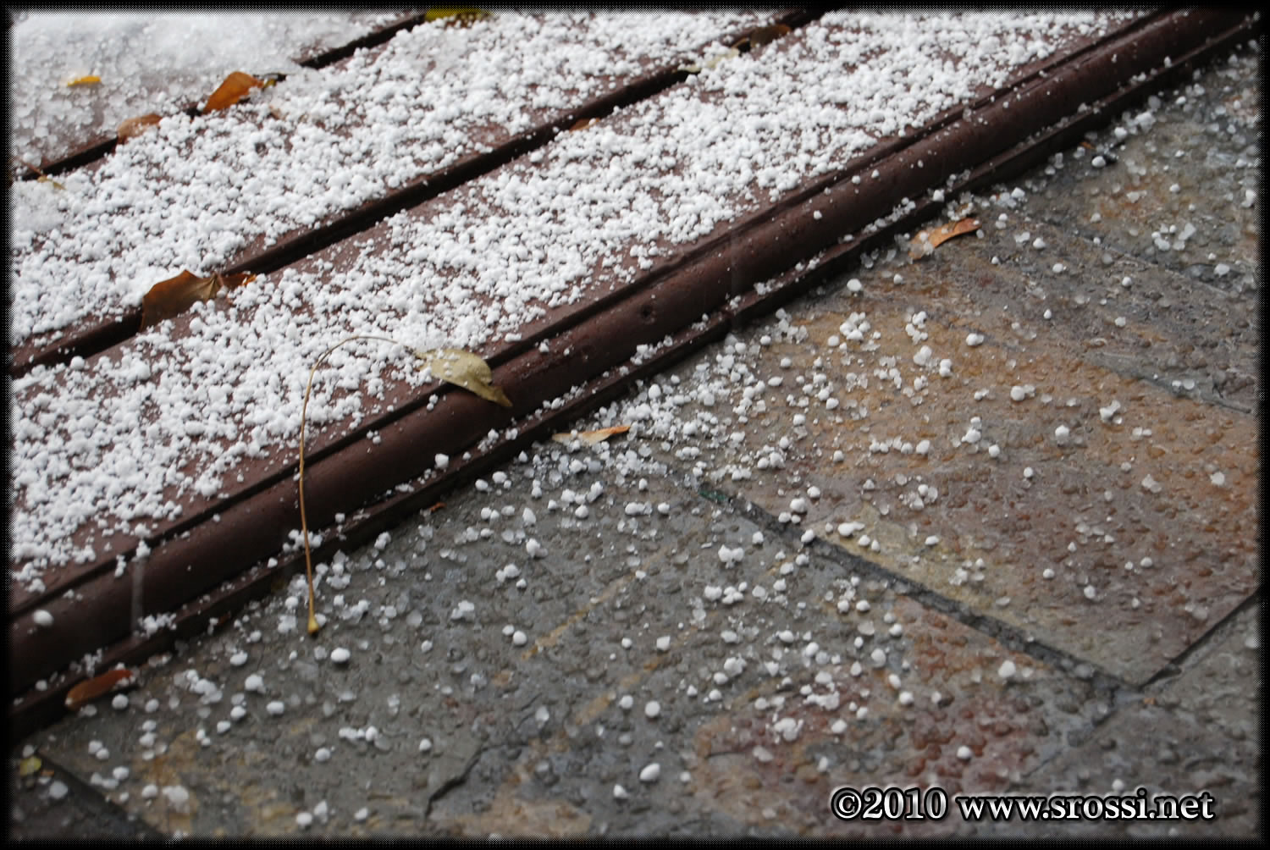
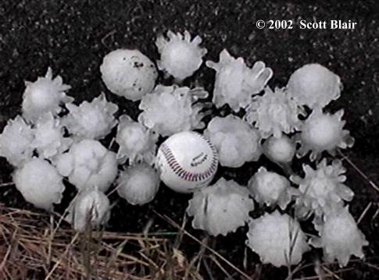
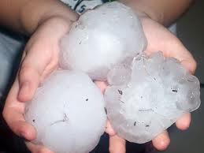
Hail

Slide 18
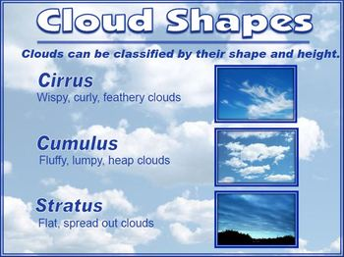
There are many different kinds of clouds, but scientists classify clouds into three main types: cumulus, stratus, and cirrus.

Slide 19
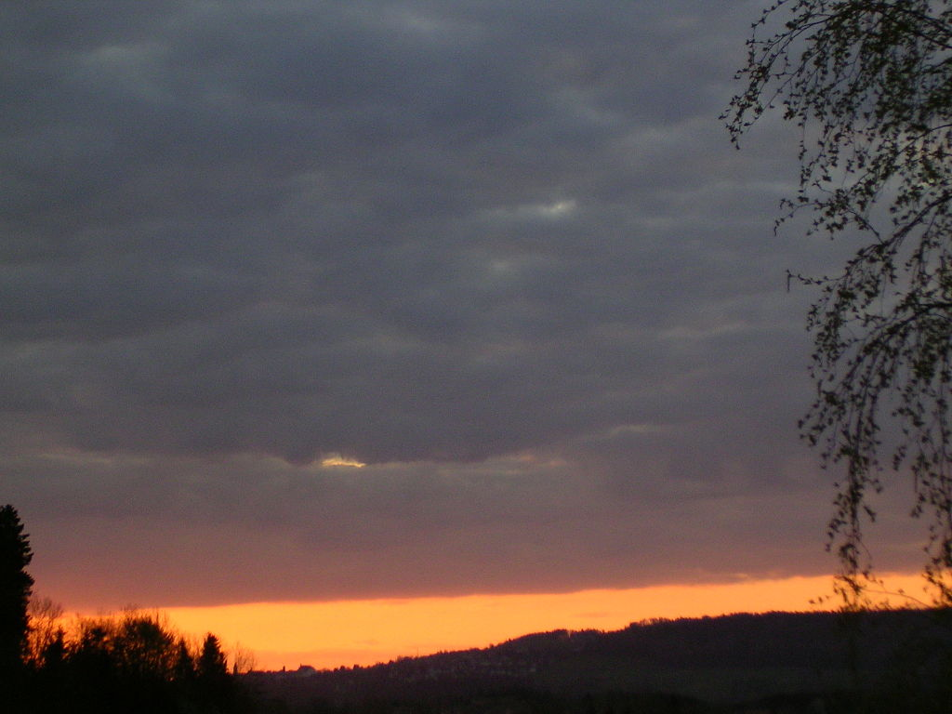
12. Low, layered clouds are called stratus clouds.

Slide 20
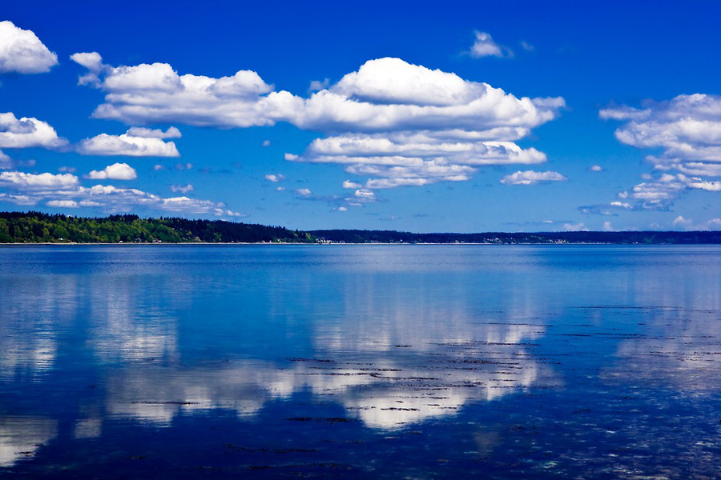
13. White, puffy cumulus clouds can become thick and dark cumulonimbus clouds that produce precipitation..

Slide 21
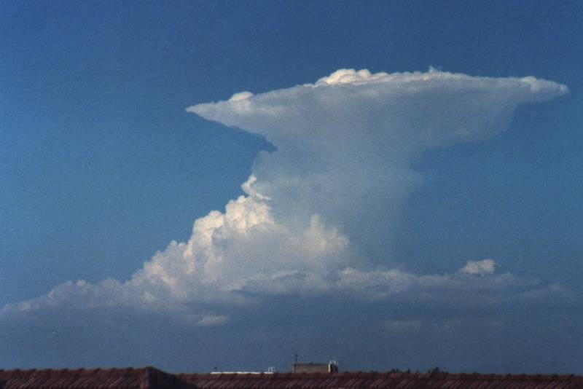
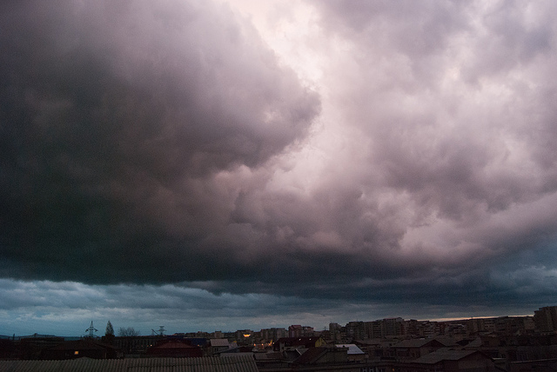
Cumulonimbus Cloud

Slide 22
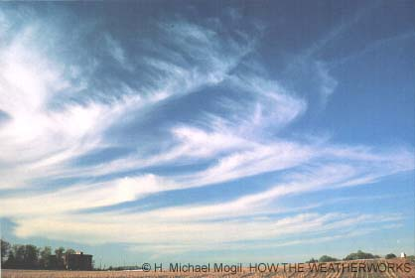
14. Thin, wispy clouds high in the sky are called cirrus clouds.

Slide 23
DO NOW
What is an example of water changing in your house??

Slide 24
15. An example in my house of water changing form is when someone takes a hot shower and the water vapor forms as steam and then drips on the mirror.

